Slide 1
Networking in the Cloud

Slide 2
Technologies and Standards
IEEE dot1q, IEEE 802.3

Slide 3
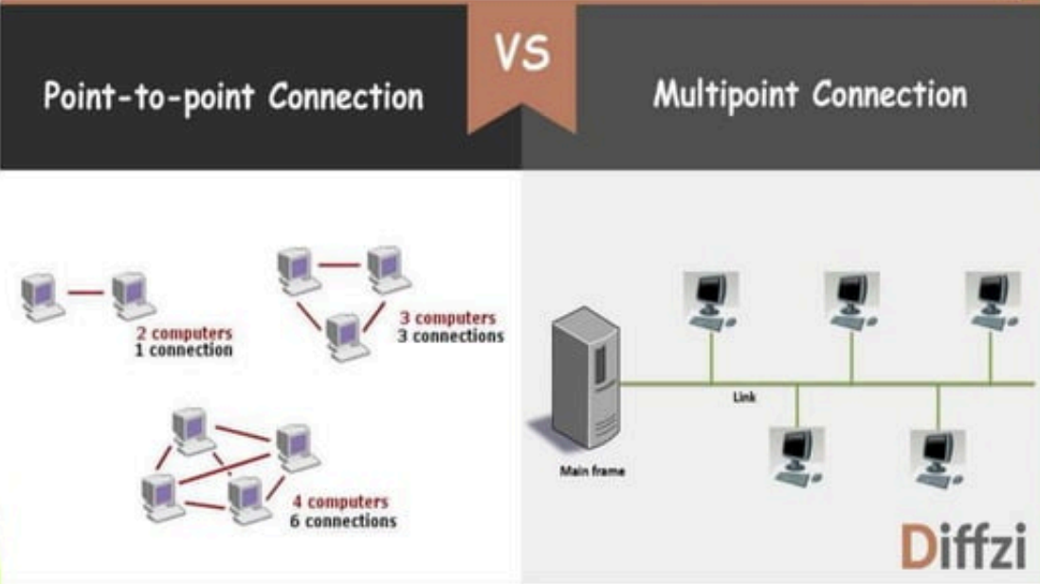

Slide 4
IEEE Standard
The IEEE 802 standards include
IEEE 802.3 standard – Ethernet
IEEE 802.4 standard –Token Bus
IEEE 802.5 standard –Token Ring
IEEE 802.11 standard – Wireless LAN
IEEE 802.15 standard – Bluetooth
IEEE 802.16 standard –Wireless MAN
IEEE 802.16 standard –FDDI
IEEE 802.16 standard –ATM LAN

Slide 5
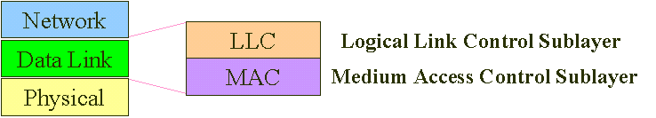
IEEE Standard
The data Link layer in the IEEE Standard is divided into two sub layers

Slide 6
IEEE Standard
Physical layer
IEEE defines detailed specifications for each LAN implementation.
The physical layer is dependent on the implementation and type of physical media used.
For example there is a different physical layer specifications for each Ethernet implementations
Data link layer:
LLC: The LLC provides one single data link control protocol for all IEEE LANs.
MAC: Provides different protocols for different LANs. Each defines the specific access method and the framing format specific to the corresponding LAN protocol.

Slide 7
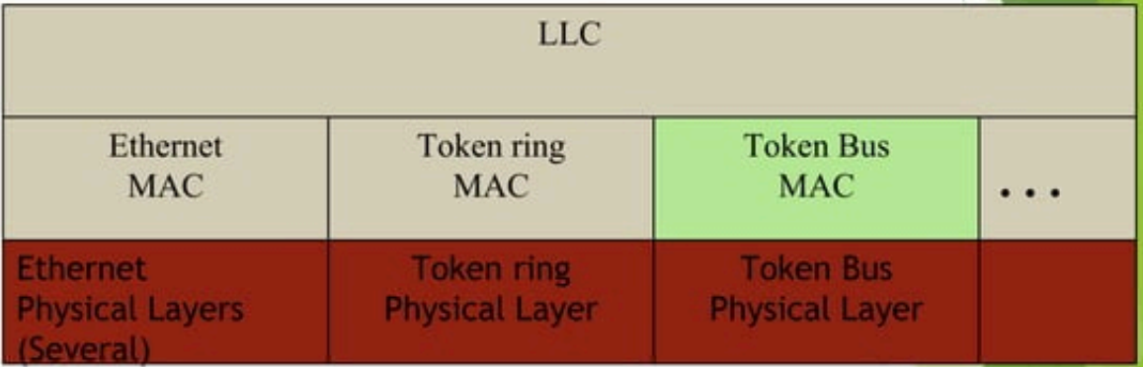
IEEE Standard

Slide 8
IEEE Standard
MAC sublayer/Physical layer
LANs typically differ only in their MAC sub layers and in their physical layers.
MAC sublayer responsibilities
Data Encapsulation / Decapsulation
Data encapsulation, including frame assembly before transmission, and frame parsing/error detection after reception
MAC sub-layer converts data received from upper layer into frames and them to physical layer.
MAC sub-layer governs the operation of the access method: Frame transmission and recovery from transmission failure due to collisions.
MAC sub-layer is slightly different for each of the Ethernet versions, the physical layer is however quite different

Slide 9
IEEE Standard
Development of Ethernet
Robert Metcalfe in his PhD thesis researched on LAN Technology.
After Graduation he joined Xerox corporation and worked with a group which implemented Ethernet(1976).
Later the concepts of Ethernet were written and proposed to the IEEE as a standard for LANs. The proposal was backed by Xerox, Intel and DEC.
Two other proposals were presented to IEEE at about the same time. One backed by General motors and the other by IBM.

Slide 10
Ethernet
Development of Ethernet
All three were made LAN standards because it was difficult for the IEEE officials to decide which of the three was the most appropriate for a LAN standard.
The IEEE adopted the Ethernet as a standard IEEE standard 802.3
The other two standards were IEEE standard 802.4 and IEEE standard 802.5
IEEE has standardized a number of local area networks and metropolitan area networks under the name of IEEE 802.

Slide 11
Ethernet Standard
Traditional Ethernet Uses bus/star topology
Uses 1-persistent CSMA/CD.
Defines 10Mbps Ethernet.
It is typically used to connect PCs, workstations, Printers, file servers and even mainframes.

Slide 12
MAC Layer
Issues
MAC Layer Issues
Frame Format
Frame assembly
Max and Min frame
Addressing
Address Format
Address transmission
Slot time
Maximum Network length

Slide 13
Ethernet Frame Format
The Ethernet frame contains seven fields.
See the frame structure below.

Slide 14
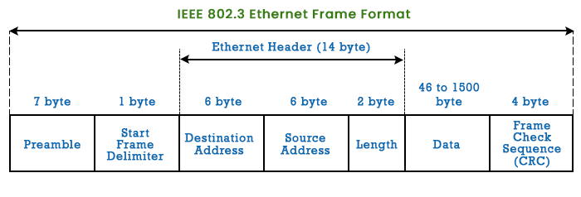

Slide 15
Ethernet Frame Format
Preamble: 7-octet (56 bits) pattern of alternating 0s and 1s used by the receiver to establish bit synchronization. The preamble is added at the physical layer and is not formally part of the frame.
Start of Frame Delimiter (SFD)-1 byte: the sequence 10101011 indicates the actual start of frame enables receiver to locate the first bit of the rest of the frame.
The last two bits are 11 and alert the receiver that the next field is the destination address.

Slide 16
Ethernet Frame Format
Destination address: The Destination address is 6 bytes and contains the physical address of the destination station for which frame is intended
Source Address: The source address is also 6 bytes and contains the physical address of the Station that sent the frame

Slide 17
Ethernet Frame Format
Length/Type:
The field is defined as a length(IEEE) or type field (Original ethernet).
If the value of the field is less than 1518, it is a length field and defines the length of the data field that follows.
Provides a pointer to the boundary between the end of data and CRC
On the other hand if the value of this field is greater than1536 it defines the type of the PDU packet (higher level protocols ) that is encapsulated in the frame.
Tells receiver what to do with the frame.
Multiple network layer protocols may be in use on the same machine
The type specifies which process to give the frame to

Slide 18
Ethernet Frame Format
LLC data:
This field carries the data supplied by upper layer protocols.
It is a minimum of 46 and a maximum of 1500 bytes.

Slide 19
Ethernet Frame Format
Pad: Octets added to ensure that frame is longenough for proper CD operation
There is always a minimum data and pad length of 46 bytes i.e. if the data length is 0 bytes, the pad has 46 bytes. If the data field is >= 46 bytes, the pad field reduces to zero
This ensures a minimum frame size of 64 bytes (18 bytes header), which ensures that collision detection works properly
Frame check sequence: 32 bit CRC, based on all fields except SFD and FCS. The FCS is generated over the DA, SA, Length/Type, and Data fields.

Slide 20
Ethernet Frame Format
Frame Assembly
Whenever an end station MAC receives a transmit-frame request with the accompanying address and data information from the LLC sublayer, the MAC begins the transmission sequence by transferring the LLC information into the MAC frame buffer.
The preamble and start-of-frame delimiter are inserted in the PRE and SOF fields.
The destination and source addresses are inserted into the address fields.
The LLC data bytes are counted, and the number of bytes is inserted into the Length / Type field.

Slide 21
Ethernet Frame Format
Frame Assembly
The LLC data bytes are inserted into the Data field. If the number of LLC data bytes is less than 46, a pad is added to bring the Data field length up to 46.
An FCS value is generated over the DA, SA, Length / Type, and Data fields and is appended to the end of the Data field.
After the frame is assembled, actual frame transmission will depend on whether the MAC is operating in half-duplex or full-duplex mode.

Slide 22
Ethernet Frame Format
Frame length:
Minimum and maximum frame length
The standard defines the minimum and maximum length of a frame (without preamble and SFD field)
Maximum = as 1518 bytes
Minimum = 64 bytes(512 bits).
802.3 standard allows for a variable length of data transfer

Slide 23
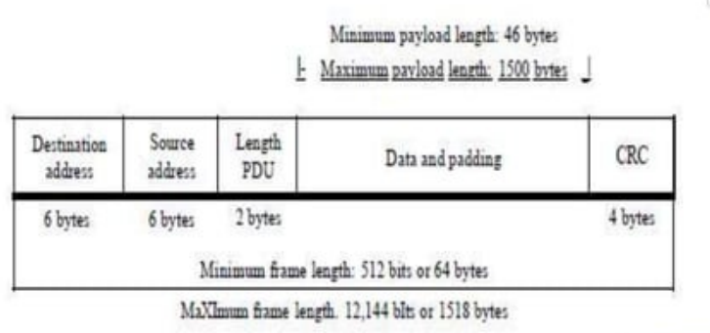

Slide 24
Ethernet Frame Format
Frame length:
Minimum and maximum frame length
Reasons for having minimum frame length
The minimum length restriction is required for the correct operation of CSMAICD
To prevent a station from completing the transmission of a short frame before it detects collision (if it occurs).
The sender should still be transmitting when a noise burst (if collision occurs) gets back to it.

Slide 25
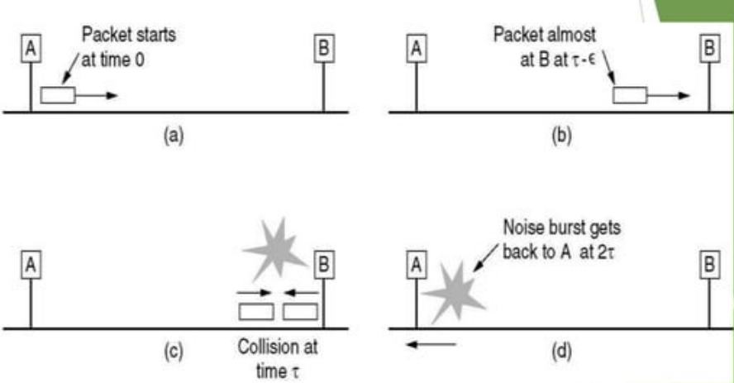
Ethernet Frame Format and CD
Collision detection can take as long as 2τ

Slide 26
Ethernet Frame Format
Addressing
Each station on an Ethernet network has it sown network interface card.
The NIC fits inside the station and provides the station with a 6-byte(48 bits) physical address.
It is normally written in hexadecimal notation using a hyphen to separate bytes from each other.
Example: 07-01-02-01-2C-4B

Slide 27
Ethernet Frame Format
Addressing
A source address is usually unicast address- the frame comes from only one station.
The destination address however can be unicast, multicast or broadcast.

Slide 28
Ethernet Frame Format
Addressing
The address length may be 16 or 48 bits- a local implementation choice
48-bit addresses are globally assigned, while 16 bit addressees are locally assigned
Global addresses are assigned centrally by IEEE to ensure that no two stations anywhere in the world have the same global address = 7 * 10¹³ global addresses.

Slide 29
Ethernet Frame Format
Addressing
The 48 bit addresses are the hardware addresses of the individual network interface cards which connect devices to the network
These addresses are used on the LAN to identify the exact stations between which the packet transfers are taking place
These addresses are often referred to as Ethernet address or MAC address

Slide 30
Ethernet Frame Format
Addressing
A broadcast or multicast facility is provided through the use of first two (high order) bits of the address field
The high order bit of the destination address is a 0 for ordinary addresses and 1 for group addresses.
XXXXXXX0 XXXXXXXX XXXXXXXX XXXXXXXX XXXXXXXX XXXXXXXX
XXXXXXX1 XXXXXXXX XXXXXXXX XXXXXXXX XXXXXXXX XXXXXXXX
A broadcast destination address is forty-eight 1s.
11111111 11111111 11111111 11111111 11111111 11111111
Bit 46 (adjacent to High order bit) is used to distinguish local from global addresses

Slide 31
Ethernet Frame Format
4A:30:10:21:10:1A
This is a unicast address because A in binary is1010 (even).
47:20:1B:2E:08:EE
This is a multicast address because 7 in binary is 0111 (odd).
FF:FF:FF:FF:FF:FF
This is a broadcast address because all digits are F's,

Slide 32
Ethernet Frame Format
Address transmission
The address is sent out on the line left to right byte by byte.
For each byte the least significant bit is sentoft first.
How the address 47:20:1B:27E:08:EE is sent out on the line
11100010 00000100 11011000 0111010000010000 01110111

Slide 33
Access method
Standard Ethernet uses 1-persistent CSMA/CD
Slot time
Slot time is defined as the time to send minimum length frame;
The slot time in Ethernet is defined in bits. It is the time required for a station to send 512 bits (The shortest possible frame).
This means that the actual slot time depends on the data rate;
Slot time = minimum length frame(bits)/datarate(bits/sec)
For traditional 10-Mbps Ethernet it is 51.2 µs.

Slide 34
Access method
Slot time and collision
The sender needs to be aware of the collision before it has sent the entire frame(512 bits).
Slot time = maximum time to detect collision
= to twice the signal propagation time between the two most-distant stations on the network.
It means that the slot time is dependent on the propagation speed of the signal in the particular medium,
The round-trip time plus the time required to send the jam sequence should be less than the time needed for the sender to send the minimum frame, 512 bits.

Slide 35
Access method
Slot time and maximum network length
Speed = Distance/Time & Time = Distance/Speed
Slot time = (MaxLength * 2)/ PropagationSpeed;
MaxLength = PropagationSpeed * SlotTime/2

Slide 36
Access method
Slot time and maximum network length
MaxLength = PropagationSpeed * SlotTime/2
Longer minimum frame lengths translate to longer slot times and larger collision diameters;
Shorter minimum frame lengths correspond to shorter slot times and smaller collision diameters.
Tradeoff between impact of collision recovery and the need to accommodate reasonable network sizes.

Slide 37
Access method
Slot time and maximum network length
In most transmission media, the signal propagates at 2.0 x 10⁸ rn/s
MaxLength = PropagationSpeed * SlotTime/2
Theoretical MaxLensth = 5200 m for standard ethernet.
= (2.0 x 10⁸ * 51.2*10⁻⁶ )/2
= (2.0 * 51.2* 10² )/2
= 5120 m (= 5200 m)
Considering the delay times in repeaters and interfaces, and the time required to send the jam sequence, Max length = 2500 m.

Slide 38
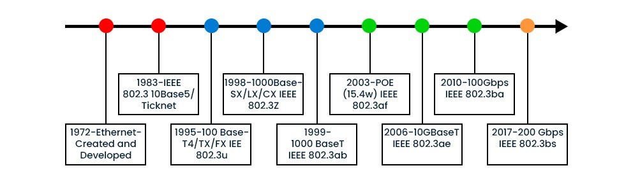
Ethernet

Slide 39
Ethernet Networks
Ethernet Evolution
The original Ethernet created in 1976 at Xerox’s Palo Alto research center has since evolved.
Ethernet has gone through a four-generation evolution during the last few decades
Standard/Traditional Ethernet: The original Ethernet had a data rate of 10Mbps
Fast Ethernet operates at 100Mbps
Gigabit Ethernet Operates at 1Gbps
10 gigabit Ethernet Operates at 10Gbps
100 gigabit Ethernet Operates at 100Gbps

Slide 40
Bridged Ethernet
The first step in the evolution was division of the LAN by bridges.
Effect of Bridges on the LAN:
Raising the bandwidth: A bridge divides a network into two or more segments, each independent. It reduces the number of stations sharing the capacity of the segment. Results in a gain of more bandwidth for each segment.
Separating collision domains: gives rise to smaller collision domains, reducing the probability of collisions.

Slide 41
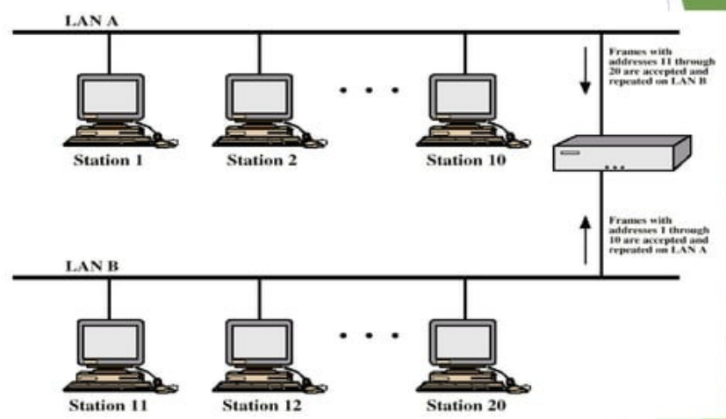

Slide 42
Switched Ethernet
The next step was the evolution from bridged Ethernets to Ethernets .
The switched Ethernets were an extension of the idea of a bridged LAN to an N-port bridge. This led to even faster Ethernet.
A layer 2 switch is an N-port bridge with additional sophistication that allows faster handling of frames(switching, cut through etc.)
Effect of switches on the LAN
Increased bandwidth:
The switch divides a network into N independent segments where N is the number of stations in the LAN. Bandwidth shared only between the station and the switch.
Single user per collision domain:
Gives rise to N collision domains with one user per segment, reducing the probability of collisions even further.

Slide 43
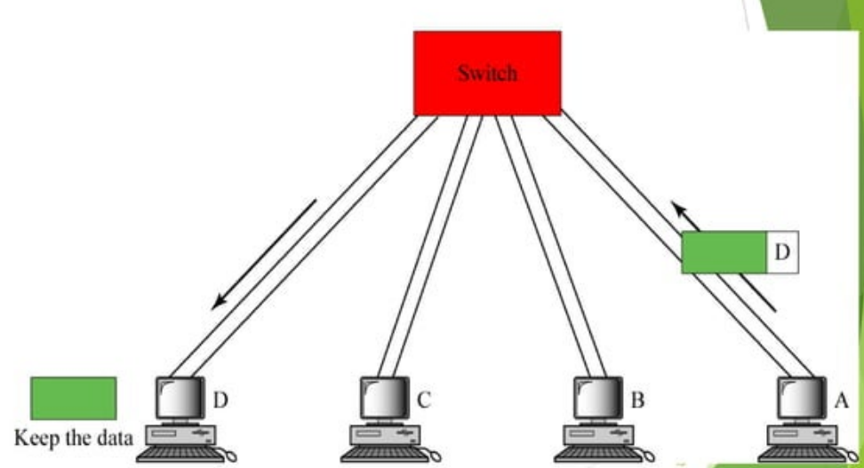

Slide 44
Switched Ethernet
In full duplex switched Ethernet there is no need for CSMA/CD access method.
Each station is connected via two separatelinks.
Each link is a point to point dedicated path between the station and the switch.
Station can send and receive simultaneously.
No possibility of collision.
The carrier sense and collision detection functionality can be switched off.

Slide 45
Switched Ethernet
The backoff feature which contributes to reduced performance is mainly avoided and increased performance is achieved
The links however may still operate in half duplex mode (backward compatibility)
It is possible to run a port connection in fullduplex mode

Slide 46
Fast Ethernet
Fast Ethernet
To allow for an increased speed of transmission, the Ethernet protocol has developed a new standard to provide low cost Ethernet compatible LAN, operating at 100Mbps
Fast Ethernet is a collective term for a number of Ethernet standards that carry traffic at 100Mbps.
The Standard is referred to as 100Base-T
This is commonly called Fast Ethernet.

Slide 47
Fast Ethernet
Fast Ethernet
Fast Ethernet was required to provide backward compatibility earlier Ethernet networks, including the existing IEEE 802.3 frame format and error-detection procedures, plus all applications and networking software running on the 10-Mbps networks.
Fast Ethernet is similar to 10Mbps Ethernet in many ways
MAC sub-layer is untouched- CSMA/CD is the access method Full Duplex Fast Ethernet does not need CSMA/CD. But implementation keeps CSMA/CD for backward compatibility with traditional Ethernet.
Frame format
Minimum and maximum frame lengths
Addressing
The only difference is in the slot time and maximum network length

Slide 48
Fast Ethernet
Fast Ethernet
Slot time and maximum network length
At 100 Mbps:
Slot time = 5.12 µs . A minimum-length frame can betransmitted in approximately one-tenth (1/10) of the defislot time.
Signal propagation velocity is essentially constant for atransmission rates.
The time required to transmit a frame is inversely related to the transmission rate
lf collision occurs during the transmission (of minimum frame)would not be detected by the transmitting stations:
This means that the maximum network diameters specifie10-Mbps networks could not be used for 100-Mbps net

Slide 49
Fast Ethernet
Slot time and maximum network length
At 100 Mbps:
The solution for Fast Ethernet was to reduce the maximum network diameter by approximately a factor of 10 while retaining the minimum frame length.
Maximum network length = a little more than 200 meters. Theoretical maximum is 512 m.
MaxLength = PropagationSpeed * SlotTime/2
Theoretical MaxLength = 512 m for fast ethernet
Considering the delay times in repeaters and interfaces, and the time required to send the jam sequence, Max length = 250 m.

Slide 50
Gigabit Ethernet
One of the more recent developments in the Ethernet standard is a protocol that has a transmission speed of 1 Gbps.
Describes various technologies for transmitting Ethernet packets at a rate of1Gbps.
It can be used with both fiber optic cabling and copper.

Slide 51
Gigabit Ethernet
All configurations are point-to-point rather than multi-drop as in the traditional Ethernet.
Compatible with 10BASE-T and 100BASE-T preserving a smooth migration path

Slide 52
Gigabit Ethernet
Gigabit Ethernet while defining a new medium and transmissionspecification, retains the same (as in 10Mbps and 100Mbps)
CSMA/CD
Frame format
Addressing
The aim was to keep MAC sub-layer untouched - not possible
Gigabit Ethernet supports two different modes of operation: fullduplex and half duplex.
Half duplex using CSMA/CD. Uses a hub rather than a switch. Simulates the multi-drop cable in traditional Ethernet. Complicated and not in use.
Full Duplex with no need for CSMA/CD: “Normal mode”: Almost all implementations use the full duplex approach

Slide 53
Gigabit Ethernet
Half duplex operation
Slot time and maximum network length
At 1000 Mbps:
Slot time = 0.512 µs. A minimum-length frame can be transmitted in approximately one-hundredth (1/100) of the defined slot time;
If collision occurs during the transmission (of minimum frame) it would not be detected by the transmitting stations
This means that the maximum network diameter specified for 100 Mbps networks could not be used for 1000-Mbps networks.

Slide 54
Gigabit Ethernet
Half duplex operation
Slot time and maximum network length
At 1000 Mbps:
The solution for Gigabit Ethernet was to retain the maximum network diameter same as 100-Mbps networks while increasing the minimum frame length.
reducing network diameter further by a factor of 10 to 20m impractical
By adding a variable-length non data extension field to frames that are shorter than the minimum length (the extension field is removed during frame reception).

Slide 55
Gigabit Ethernet
Half duplex operation
Enhancements to the basic CSMA/CD scheme
Carrier extension:
Frame Bursting
These features extend the radius of the network for gigabit ethernet over copper cabling. They are added to sustain the CSMA/CD protocol.

Slide 56
Gigabit Ethernet
Half duplex operation
Carrier extension:
Sending hardware to add its own padding toa normal MAC frames to extend a frame to 520 bytes.
This is so that the length of a transmission is longer than the propagation time at 1Gbps
Receiving hardware removes the padding.

Slide 57
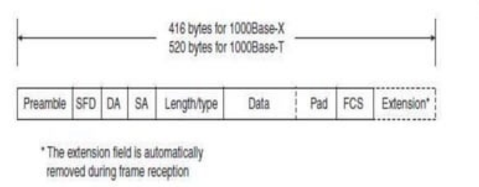

Slide 58
Gigabit Ethernet
Half duplex operation
Frame Bursting
Another change to the Ethernet CSMA/CD transmit specification was the addition of frame bursting for gigabit operation.
Allows sender to transmit a short sequence (a burst) of multiple frames equal to approximately 5.4 maximum-length frames in a single transmission without relinquishing control of the medium.
Avoids the overhead of carrier extension when a single station has a number of small frames ready to send

Slide 59
Gigabit Ethernet
Half duplex operation
Frame Bursting
If the length of the first frame is less than the minimum frame length, an extension field is added to extend the frame length.
Subsequent frames in a frame-burst sequence do not need extension fields, and a frame burst may continue as long as the burst limit has not been reached.
If the burst limit is reached after a frame transmission has begun, transmission is allowed to continue until that entire frame has been sent.

Slide 60
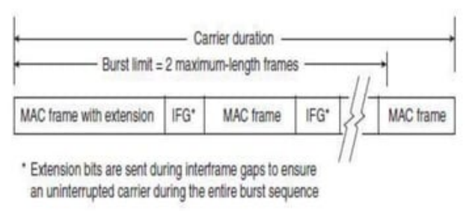

Slide 61
Gigabit Ethernet
Full duplex operation
Full-duplex operation is an optional MAC capability that allows simultaneous two-way transmission over point-point links.
With a switching hub which provides dedicated access to the medium:
Involves no media contention, no collisions, no need to schedule retransmissions, and no need for extension bits on the end of short frames.
Since no contention is possible, the CSMA/CD protocol is not used
Carrier extension and frame bursting is not need

Slide 62
Gigabit Ethernet
Full duplex operation
Data transmission and reception can occur simultaneously without interference and with no contention for share medium.
All lines are buffered so each computer can send frames whenever it wants. No need to sense the channel because contention is not possible.
On the line between a computer and a switch, the computer is the only possible sender on that line to the switch and the transmission succeeds even if the switch is currently sending a frame to the computer because, the line is full duplex.
Each link supports full-rate, simultaneous, two-way transmission

Slide 63
Gigabit Ethernet
Full duplex operation
Transmission can usually begin as soon as frames are to send. The only restriction is that there must be a minimum-length interframe gap between successive frames.

Slide 64
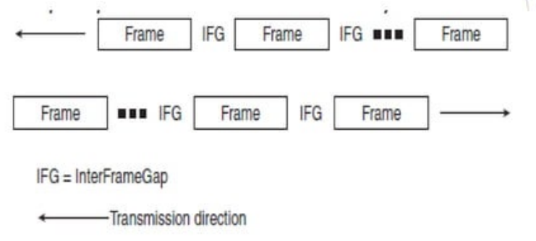

Slide 65
Gigabit Ethernet
Full duplex operation
Flow control
Full-duplex operation requires concurrent implementation optional flow-control capability that allows a receiving node (switch or station) that is becoming congested to request the sending node (such as a file server) to stop sending frames for selected short period of time (pause time).
The receiving device sets timer for specified pause time stops sending data frames. Resumes sending frames when timer expires.
Control is MAC-to-MAC through the use of a pause frame that is automatically generated by the receiving MAC.
Device can send overlapping pause packets. A pause packet cancels the previous pause packet. Receiver sets timer to the new pause period.
For example, if the congestion is relieved before the requeste wait has expired, a second pause frame with a zero time-value can be sent to request resumption of transmission

Slide 66
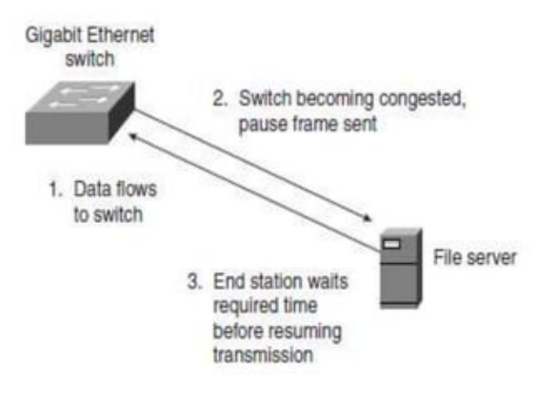

Slide 67
Gigabit Ethernet
Full duplex operation
Flow control
The MAC control sublayer is added between LLC and MAC sublayers. Data link layer now has three sublayers: LLC, MAC control and MAC
MAC control is an optional sublayer; implementation left to manufacturer.
The MAC control sublayer provides error and flow control. Special MAC control packets are inserted between packets coming from upper layers.
MAC control packet encapsulated in a MAC frame. Should be —minimum size packet(46 bytes). MAC control packet contains two byte code with value 000116 and a 44-byte pause time (a factor the time slot) + padding if any.
Currently only one MAC control packet is defined. The Pause packet.

Slide 68
Ethernet
Ethernet Components
There are several ways to connect devices
A PC connects to the Cable through some hardware
A transceiver attaches directly to network cable
The transceiver communicates with the PC using a transceiver cable.

Slide 69
Ethernet
Ethernet Components
The transceiver cable connects to the PC through a Network interface card (NIC) installed in the PC.
The NIC contains the logic necessary to:
Buffer data and move it between the transceiver cable and the PC's memory.
Do error checking, create frames, determine when to transmit (after collisions occur) and recognize frames destined for its PC.
The NIC performs the functions appropriate for the MC layer protocol.
The NIC also relieves the PC’s processor from these tasks and allows it to attend typical PC activities.

Slide 70
Ethernet
Ethernet cabling specification
IEEE 802.3 committee responsible for defining alternative physical configurations
The standard dictates the maximum length of a segment, the type of cable, the type of a tap or connection, and the connection spacing.
Each cabling option carries with it a different set of physical layer constraints (e.g., max. segment size, nodes/segment, etc.)
To distinguish the various implementations, the committée has developed a concise notation.
<data rate><Signaling method><Max segment length>
in Mbps Base(baseband) rounded to100m

Slide 71
Ethernet
Ethernet cabling specification
There are several different variations of the Ethernet standard as defined by IEEE 802.3 They differ by
Medium used in a segment
The maximum segment length
The number of stations that can connect to the segment
The data rates
Examples:
10 Base5- 10 Mbps, Baseband,500m Maximum length
10 Base2- 10 Mbps, Baseband,200m Maximum length

Slide 72
Traditional Ethernet Cabling Options
Traditional Ethernet
Defines four different implementations for the10Mbps Ethernet.

Slide 73
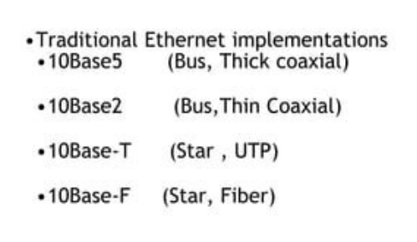

Slide 74
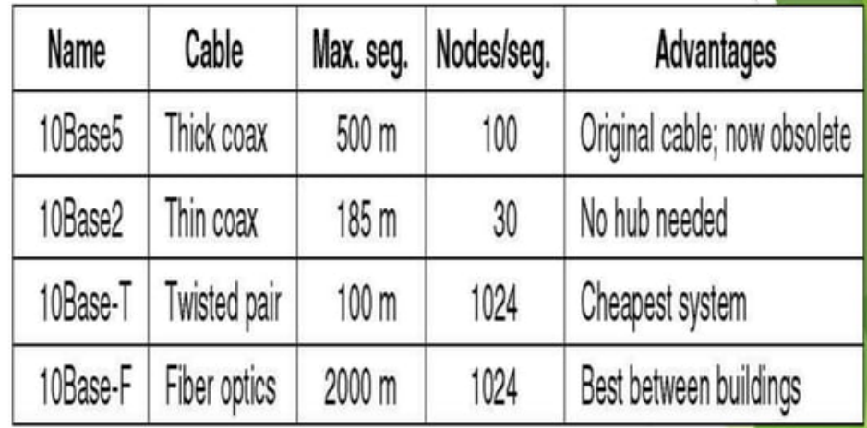
Ethernet Cabling Options

Slide 75
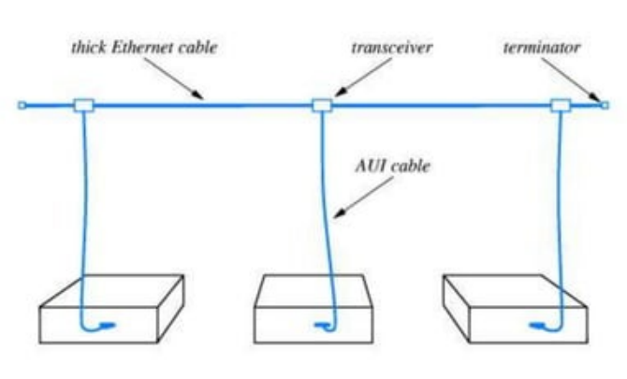
Ethernet- 10Base5

Slide 76
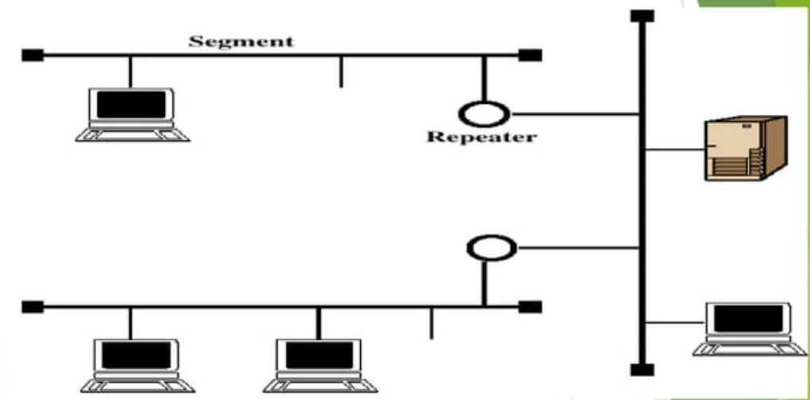
Ethernet- 10Base5

Slide 77
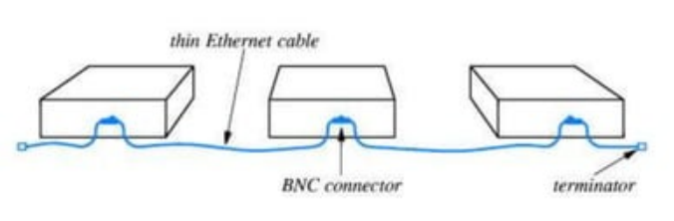
Ethernet- 10Base2

Slide 78
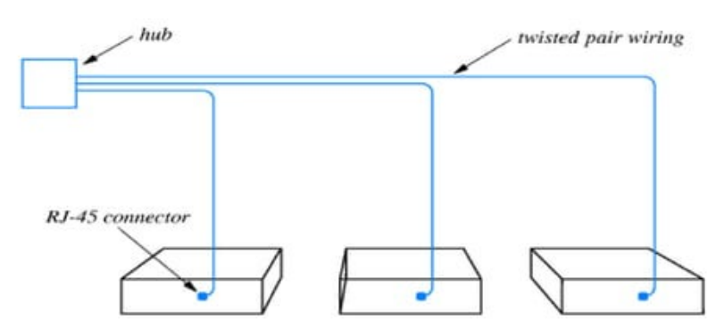
Ethernet- 10BaseT

Slide 79
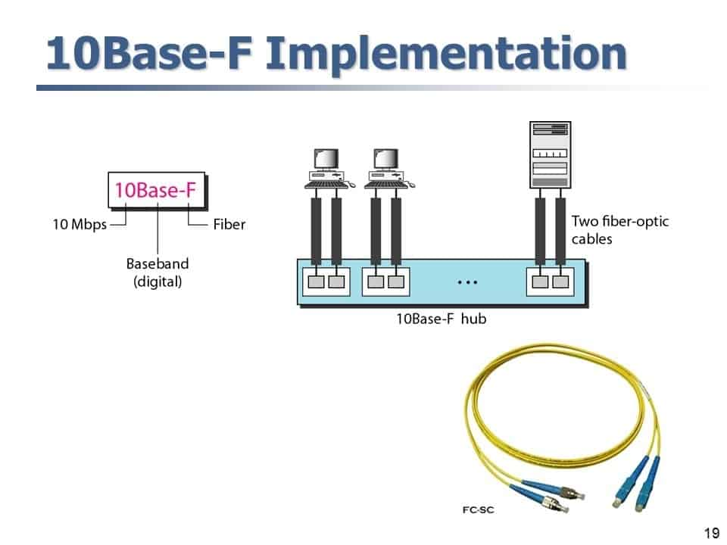
Ethernet- 10BaseFL

Slide 80
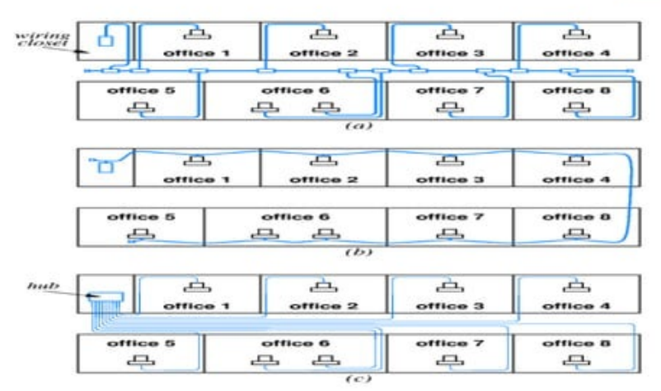
10 Mbps Ethernet Cabling Options

Slide 81
Fast Ethernet Cabling Options
Fast Ethernet
Defines three different implementations for the 100Mbps Ethernet.

Slide 82
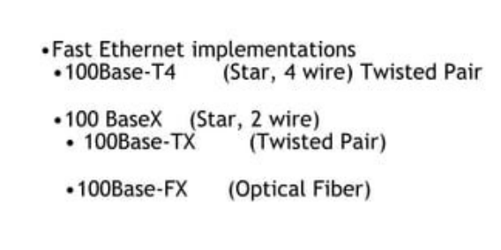
Fast Ethernet Cabling Options

Slide 83
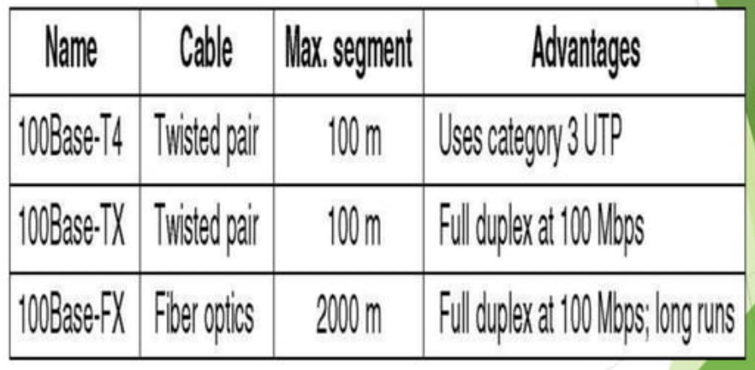
Fast Ethernet

Slide 84
Gigabit Ethernet Cabling Options
Gigabit Ethernet
Defines four different implementations for the1000Mbps Ethernet.

Slide 85
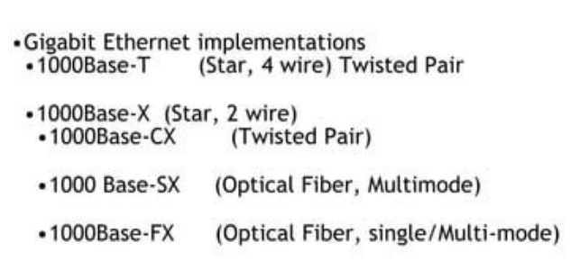
Gigabit Ethernet Cabling Options

Slide 86
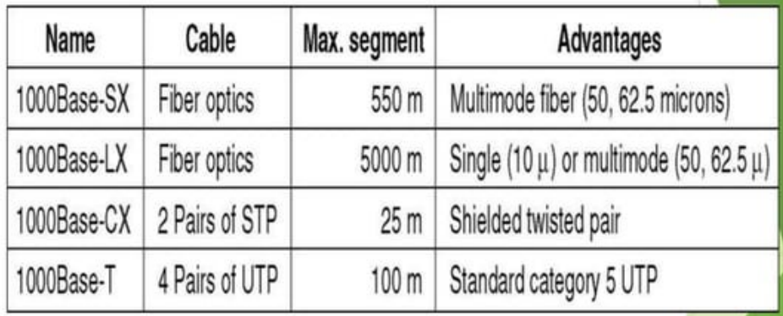
Gigabit Ethernet Cabling Options

Slide 87
Gigabit Ethernet
Typical application of Gigabit Ethernet is to provide backbone connectivity:
e.g. for central server and work group hubs
Example: (see next slide)
Workgroup hubs support both 1Gbps links to connect to the backbone Hub and to support high performance work group servers, and 100Mbps links to support high performance workstations, servers and 100Mbps hubs

Slide 88
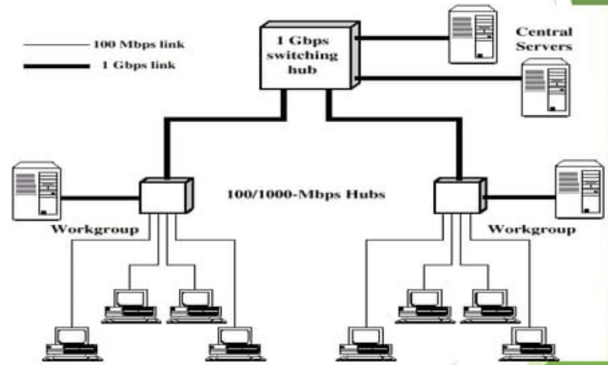

Slide 89
LAN Architecture
LLC Services
The LLC sublayer is responsible for supplying services to the user of the local area network.
LLC provides connectionless and connection oriented services, Connectionless services may be acknowledged or unacknowledged
The three services provided are:
Unacknowledged connectionless service
Acknowledged connectionless service
Connection mode service

Slide 90
LAN Architecture
LLC Protocol
LLC is modeled after HDLC in operation and format. The basic LLC protocol is modeled after HDLC and has similar functions and formats. The differences between the two protocols can be summarized as follows:
LLC makes use of the asynchronous balanced mode of operation of HDLC, to support connection-mode LLC service; this is referred to as type 2 operation. The other HDLC modes are not employed.
LLC supports an unacknowledged connectionless service using the unnumbered information PDU; this is known as type 1 operation.
LLC supports an acknowledged connectionless service by using two new unnumbered PDUs; this is known as type 3 operation.
LLC permits multiplexing by the use of LLC service access points(LSAPs)
All three LLC protocols employ the same PDU format which consists of four fields

Slide 91
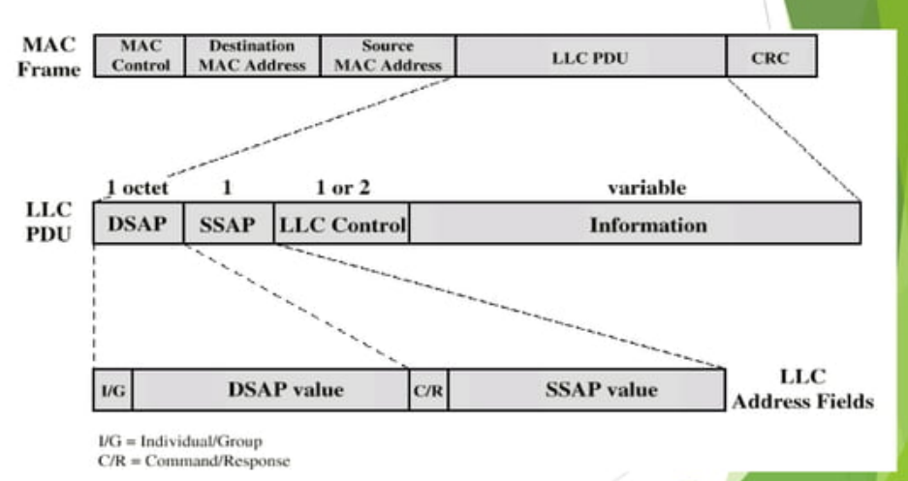

Slide 92
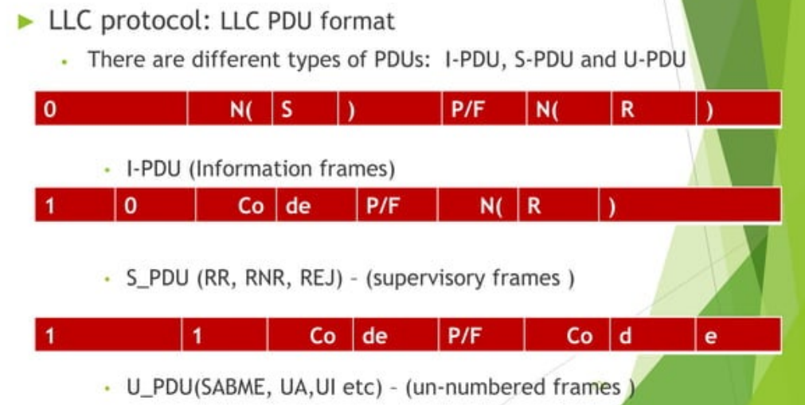

Slide 93
LAN Architecture
LLC Service/Protocol association
Unacknowledged connectionless service
This service uses the following PDUs(UI, XID, TEST).
The local user requests for data transfer from the LLC (DL-UNITDATA. request).
The local LLC sends a UI-PDU to the remote LLC.
The remote LLC informs the remote user of the data received (DL-UNITDATA. indication)
Acknowledged connectionless service
This service uses the following PDUs (AC).
The local user requests for data transfer from the Luc (DATA-ACK. request).
The local LLC sends an AC PDU with sequence number 0 to the remote LLC.
The remote LLC informs the remote user of the data received (DL-DATA-ACK. indication) and also acknowledges the receipt by sending an AC PDU with sequence number 1

Slide 94
LAN Architecture
LLC Service/Protocol association
Connection oriented sevice
Connection
The local user requests a connection from the LLC (DL_CONNEC.request)
The Local LLC sends an SABME PDU to the remote LLC. Remote LLC informs the remote user (DL-CONNET. indication)
If the remote user agrees to the connection(DL-CONNET.response) remote LLC response with UA PDU to the local LLC
The local LLC informs the local user (DL-CONNET.confirm)

Slide 95
LAN Architecture
Data transfer
The local user requests for data transfer from the LLC (DL-DATA.request)
The local LLC sends an |-PDU to the remote LLC.
The remote LLC informs the remote user of the data received (DL-_DATA. indication)
Acknowledgement can be sent from the remote LLC using S-PDU. Piggybacking can take place if remote user has data to send.
Disconnection
The local user requests a disconnection from the LLC(DL_DISCONNECT. request)
The local LLC sends a DISC to the remote LLC
The remote LLC informs the remote user of the request (DL-DISCONNECT. indication)
The remote LLC sends a UA PDU to confirm the discon nec

Slide 96
Thank You !!!

